Slide 1
Line-of-business application migration
Notes:
Last test fix June 2020 (no changes to this slide deck)
Last update September 2021

Slide 2
Abstract and learning objectives
In this whiteboard design session, you will look at how to design an Azure migration for a heterogenous customer environment. The existing infrastructure comprises both Windows and Linux servers running on both VMWare and physical machines and includes some legacy servers. Throughout the whiteboard design session, you will look at the various options and services available to migrate heterogenous environments to Azure.
At the end of this workshop, you will be better able to design and implement the discovery and assessment of environments to evaluate their readiness for migrating to Azure using services including Azure Migrate and Azure Database Migration Service.

Slide 3
Step 1: Review the customer case study
Outcome
Analyze your customer needs.
Timeframe
15 minutes

Slide 4
Customer situation
Fabrikam Fabrics is a major manufacturer and distributor of clothing and soft furnishing materials.
Founded in 1972 and based in Columbus, Ohio
Turnover in 2018 exceeded 350 million USD
Notes:
Fabrikam Fabrics is a major manufacturer and distributor of clothing and soft furnishing materials. Founded in 1972 and based in Columbus, Ohio, their business comprises three major product families (clothing, upholstery, and technical fabrics). Customers comprise familiar brand-name clothing manufacturers and furniture manufacturers, and also includes large-scale uniform suppliers to the US military. Turnover in 2018 exceeded 350 million USD.

Slide 5
Customer situation
Sprawling IT estate, including a substantial legacy server footprint
Windows servers including both x32 and x64 hardware running Windows Server 2003 through to 2016
Linux servers running a mix of RHEL 6.10 and 7 series (7.2 through 7.6) and Ubuntu 16.04
The above servers comprise both physical machines as well as VMs hosted on VMware infrastructure managed by vCenter 6.5
Multiple database engines, including Microsoft SQL Server, PostgreSQL, and Cassandra
448 servers identified
No clear view of entire estate
Notes:
The CTO, James Lynch, was hired 6 months ago from outside the company, with a mandate to address ever-increasing IT costs. He has identified a sprawling IT estate, including a substantial legacy server footprint. New servers and services have been accumulated over time, without consolidating existing infrastructure. This includes:
- Windows servers including both x32 and x64 hardware running Windows Server 2003 through to 2016
- Linux servers running a mix of RHEL 6.10 and 7 series (7.2 through 7.6) and Ubuntu 16.04
- The above servers comprise both physical machines as well as VMs hosted on VMware infrastructure managed by vCenter 6.5
- Multiple database engines, including Microsoft SQL Server, PostgreSQL, and Cassandra
In total, 448 servers and VMs have been identified to date, distributed across 5 main locations, all in the US. There is a complex web of dependencies between servers and no-one has a clear view of the entire estate. Fear of breaking an existing system has been one of the drivers of server count and sprawl.

Slide 6
Customer situation
The CTO, James Lynch, was hired 6 months ago from outside the company
Mandate to address ever-increasing IT costs
Board has approved strategy to migrate as much existing IT infrastructure as possible to Azure
Goals:
Eliminate IT infrastructure overheads
Clean house
Create a modern, fit-for-purpose IT environment
Save costs
Notes:
To address this, James has proposed to the board that Fabrikam should migrate as much of the existing IT infrastructure as possible to the cloud. As well as eliminating IT infrastructure overheads, this will be an opportunity to 'clean house' and create a modern, fit-for-purpose IT environment, as well as realizing substantial cost savings relative to their current infrastructure. The board have agreed, and Microsoft Azure has been selected as the cloud provider.

Slide 7
Customer needs
Identify which servers (physical and virtual) can be migrated to Azure, and what modifications (if any) are required.
Create a road map of prioritized migrations, accounting for ease of migration and dependencies.
Where suitable, migrate existing servers and databases to Azure as efficiently as possible.

Slide 8
Customer needs
Where existing servers cannot be migrated, identify alternative migration strategies (refactor, re-architect, etc.) and their pros/cons.
Prior to migration, accurately forecast the costs associated with each migrated workload, including any third-party licensing costs.
Post-migration, be able to track costs, control usage, cross-charge business owners, identify cost-saving opportunities, and provide examples of better utilizing resources.
What customer services could be more efficiently run or managed by moving them to Azure PaaS services?

Slide 9
Customer objections
Owners of each business application will require evidence that migration will be successful before granting approval.
Fabrikam have negotiated an Enterprise Agreement (EA) with Microsoft for their Azure consumption. Any cost estimates need to reflect their EA discount.
Many applications comprise multiple components or tiers. How can you ensure that these migrations are appropriately orchestrated?

Slide 10
Customer objections
To reduce business impact, each migration should be designed to minimize application downtime. In addition, to risk, there must be an option to fail-back should the migration experience an unexpected problem.
We are expecting to move all our existing infrastructure to Azure. Reducing our on-premises server costs should provide substantial cost savings. Can you confirm what savings we can expect?

Slide 11

Common scenarios
Azure Migrate
Azure Database Migration Service Microsoft Data Migration Assistant
Azure Migrate can assess your VMware environment for Azure suitability, sizing recommendations and cost estimates.
Azure Migrate supports migration of VMware environments, using an agentless migration architecture.
Physical server migration is also supported. Azure Migrate uses a migration engine based on Azure Site Recovery in this case.
Azure Database Migration Service migrates on-premises database to Azure with minimal downtime.
The Microsoft Data Migration Assistant supports the Database Migration Service by performing database compatibility assessments and schema migration.

Slide 12
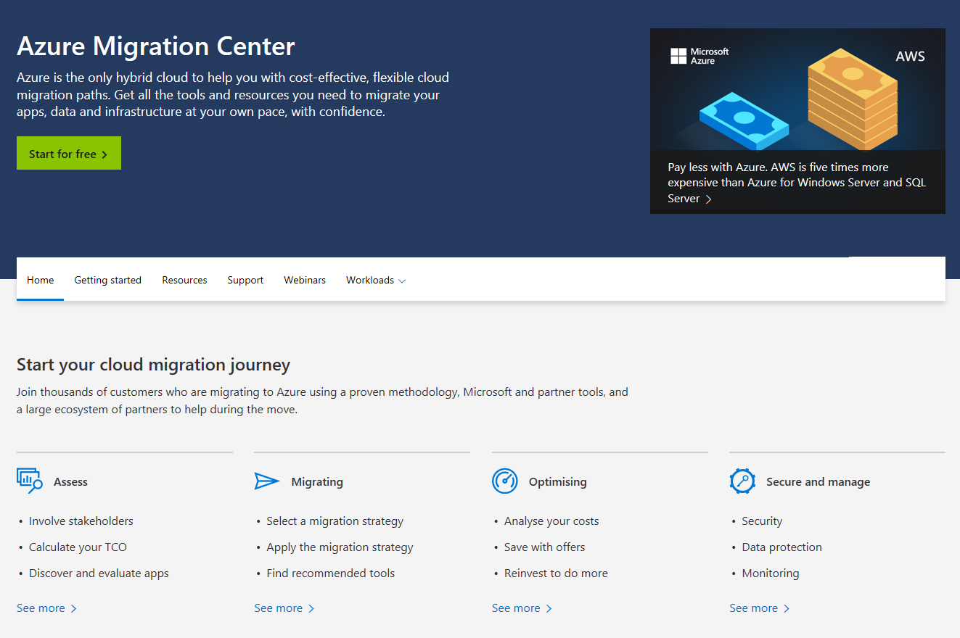
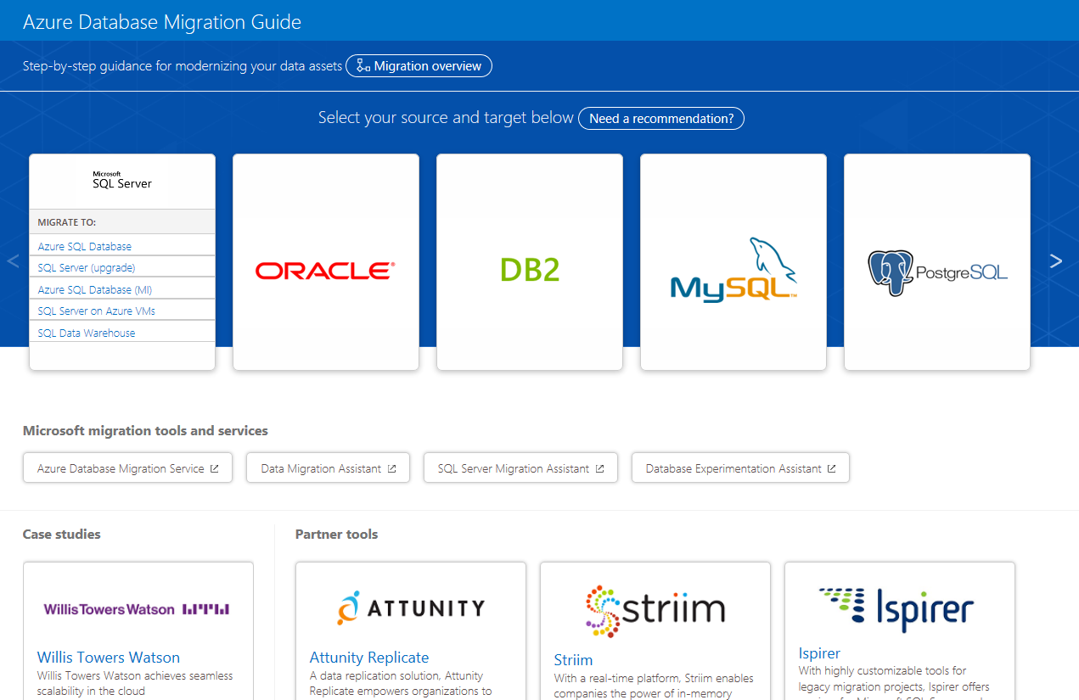
Key Resources
https://azure.microsoft.com/migration
https://aka.ms/datamigration

Slide 13
Best Practices
Cloud Adoption Framework https://docs.microsoft.com/azure/cloud-adoption-framework/
Well-Architected Framework https://docs.microsoft.com/azure/architecture/framework/
Azure Landing Zones https://docs.microsoft.com/azure/cloud-adoption-framework/ready/landing-zone/

Slide 14
Step 2: Design the solution
Outcome
Design a solution and prepare to present the solution to the target customer audience in a 15-minute chalk-talk format.
Timeframe
60 minutes
Business needs (10 minutes) | Respond to questions outlined in your guide and be prepared to present your solution to others.
Design (20 minutes) | Design a solution for as many of the stated requirements as time allows.
Prepare (15 minutes) | Identify any customer needs that are not addressed with the proposed solution Identify the benefits of your solution Determine how you will respond to the customer’s objections Prepare for a 15-minute presentation to the customer

Slide 15
Step 3: Present the solution
Outcome
Present a solution to the target customer in a 15-minute chalk-talk format.
Timeframe
30 minutes (15 minutes for each team to present and receive feedback)
Directions
Pair with another team.
One group is the Microsoft team and the other is the customer.
The Microsoft team presents their proposed solution to the customer.
The customer asks one of the objections from the list of objections in the case study.
The Microsoft team responds to the objection.
The customer team gives feedback to the Microsoft team.
Switch roles and repeat Steps 2-6.

Slide 16
Wrap-up
Outcome
Identify the preferred solution for the case study.
Identify solutions designed by other teams.
Timeframe
15 minutes

Slide 17
Preferred target audience
James Lynch, CTO
Relevant IT department heads under James E.g. Head of Operations, Head of Application Development, etc.
Business application owners
CFO - to understand cost implications, including the CapEx/OpEx switch
CSO - to understand security implications

Slide 18
Preferred solution
Migration Assessment
VMware: Azure Migrate
Physical Servers: Azure Migrate with third-party tools
Databases:
SQL Server: Microsoft Data Migration Assistant (DMA)
PostgreSQL and Cassandra: Third-party tools (where available)
Migration Execution
VMware: Azure Migrate (agentless VMware migration)
Physical Servers: Azure Migrate, port disks or third-party tools
Databases:
SQL Server and PostgreSQL: Azure Database Migration Service (DMS)
Cassandra: CQL COPY, Databricks table copy, or third-party tools
Other: re-install, refactor, re-architect, rebuild – or Azure VMware solution

Slide 19
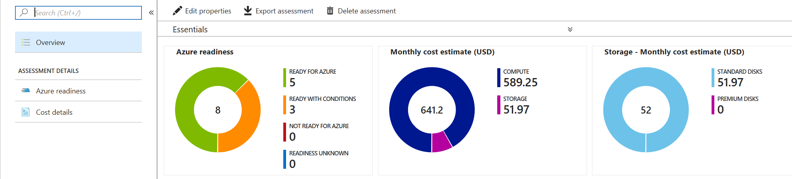
Preferred assessment solution: Azure Migrate
Assess suitability for migration
Visualize dependencies
Sizing recommendations
Cost estimates

Slide 20
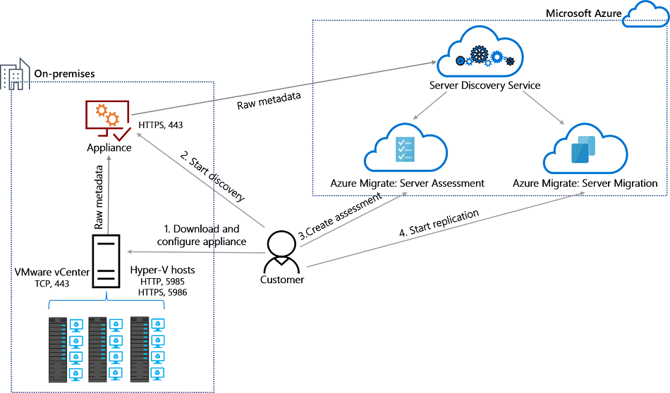
Preferred migration solution: Azure Migrate
Agentless or agent-based VMware migration options
Physical and Hyper-V support
Using Azure Site Recovery migration engine
Integrated with Migration Assessment
Incremental data transfer
Test failover
Us
Notes:
Agentless vs agent-based comparison for VMware: https://docs.microsoft.com/azure/migrate/server-migrate-overview

Slide 21
Preferred solution: Azure Database Migration Service
Use Database Migration Assistant (DMA) for SQL assessment
Use DMS for schema migration and data migration
Supports migration to Azure SQL Database services or SQL on Azure VMs
Two migration modes
Offline: simple and easy
Online: minimize downtime
Supports SQL Server, MySQL and PostgreSQL
Use Cassandra tools or 3rd-party tools for Cassandra database

Slide 22
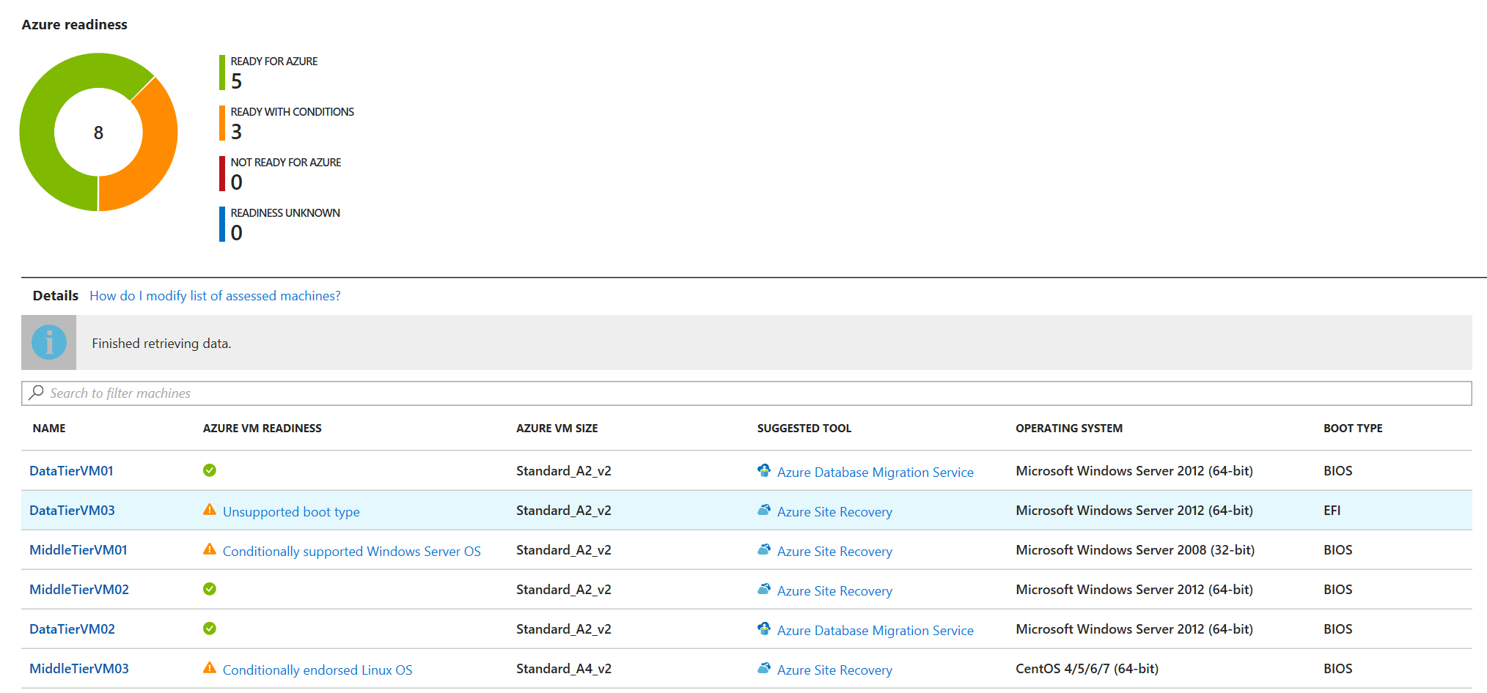
Solution Details: Readiness Report
VM Readiness
Recommended size
Suggested migration tool

Slide 23
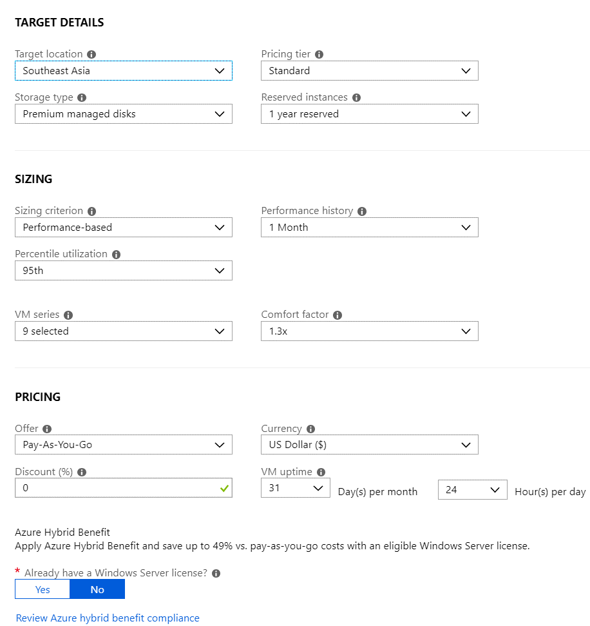

Solution Details: Cost Estimate
Configure target environment parameters to tune pricing estimate

Slide 24
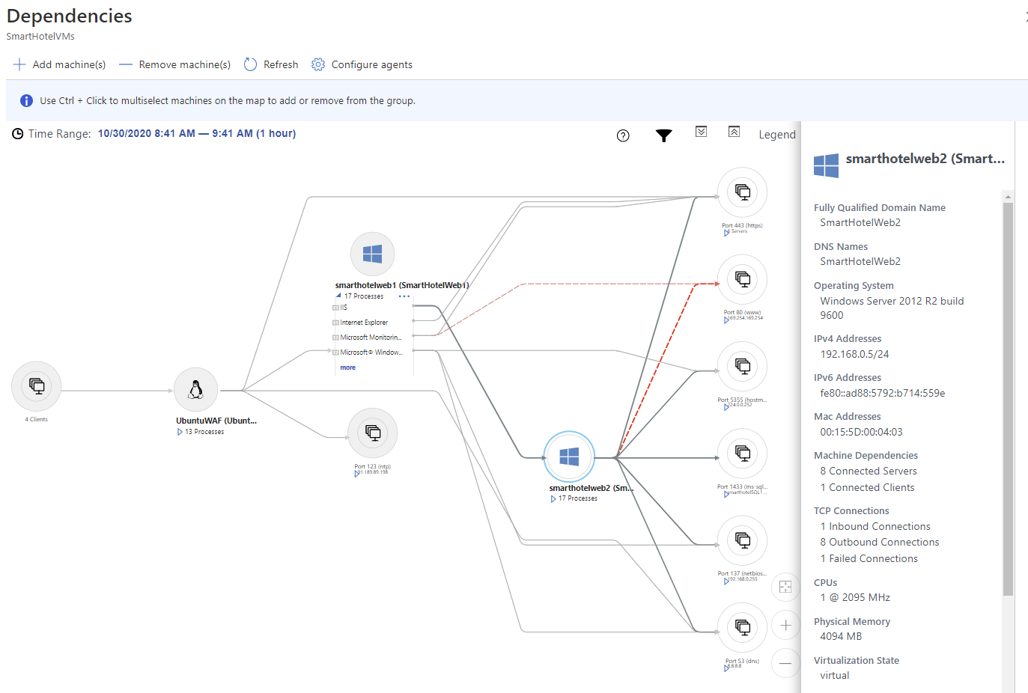
Solution Details: Dependency Visualization
Creates map of VM network dependencies
Identify related machines to plan migration groups and dependencies
Notes:
Free for 180 days. Must use a dedicated Log Analytics workspace. No solution other than Service Map may be used with this workspace.

Slide 25
Solution Details: Migration
Prepare Azure environment
Accounts, permissions, storage, network…everything except the VMs and their disks
Use Azure Landing Zones for best practices and reusable deployment artifacts
Deploy on-premises components
VMware (agent-less): Azure migrate appliance VM; nothing to install on each VM
VMware (agent-based) or physical servers: Replication appliance VM or server; plus Mobility Service agent on each VM or machine to be migrated
Configure replication policy and enable replication
Perform test failover and verify

Slide 26
Solution Details: Migration
Cut over
Update application settings (connection strings, configurations, etc)
Acceptance testing
Endpoint update (typically DNS change)
Post-migration
Install VM agent / uninstall Mobility Service agent
Review Azure Advisor / Security Center recommendations
Apply principles from the Azure Well-Architected Framework
Cost optimization (e.g. right-sizing, apply discounts, shut down in off hours)
Operational excellence (e.g. monitoring)
Performance efficiency (e.g. auto-scale)
Reliability (e.g. high availability, backup and DR)
Security (e.g. enable disk encryption, network access, Azure RBAC)
Notes:
Free for 180 days. Must use a dedicated Log Analytics workspace. No solution other than Service Map may be used with this workspace.

Slide 27
Solution Details: Database Migration Service (DMS)
Use DMA for assessment
Install on any machine with database access
Use DMS for schema and data migration
Create target DB in Azure
Create VNet with access to source and target DBs
DMS deploys into this VNet for connectivity
Use S2S VPN or ExpressRoute for on-premises access
Requires Internet access on TCP ports 443, 53, 9354, 445, 12000
Database access on port 1433 (NSGs, firewalls)
Notes:
Free for 180 days. Must use a dedicated Log Analytics workspace. No solution other than Service Map may be used with this workspace.

Slide 28
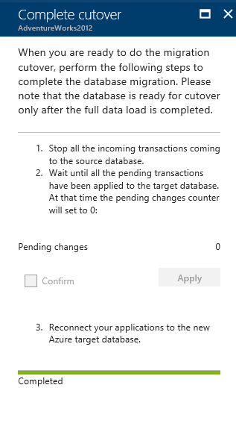
Solution Details: Database Migration Service (DMS)
Offline migration
Wait to complete
Reconfigure applications with new database connection details
Online migration
Requires 'Premium' pricing tier
Wait for initial data sync
Stop incoming transactions
Wait for pending transactions to read '0'
Stop syncing changes
Reconfigure applications with new database connection details
Notes:
Free for 180 days. Must use a dedicated Log Analytics workspace. No solution other than Service Map may be used with this workspace.

Slide 29
Solution Details: Future Updates
Services:
Existing Service | Azure PaaS Solution
UbuntuWAF | Front Door or Application Gateway with WAF
Web site on VMs | App Service Plan (Web App or Container) Azure Container Instances Azure Kubernetes Service (AKS)
VNA Firewall | Azure Firewall
DNS on VMs | Azure DNS Public Zones Azure DNS Private Zones
Log and management of VMs | Azure Monitor
Notes:
Often running generic use Virtual Machines in Azure, while reliable and easy to migrate, do not offer as many service, ease of use or scaling, or relabiliity as hosted PaaS services and often are less cost optimal as a general service then an optimized managed solution. Therefore it is often helpful to identify services that could be augmented or replaced in future updates once those services are deployed in Azure.
Some service such as Azure Monitor can be deployed easily but might require more setup & tuning for the environment. Other services such as moving to AKS may require a fair amount of application redesign or rewrite, but offer a host of dynamic & reliability while providing a quick update and deployment solution.
Addressing proposed Questions:
1. What type of services housed in general purpose VMs used by Fabrikam could be replaced by Azure services?
* UbuntuWAF -> Front Door or Application Gateway with WAF
* Web site on VMs -> App Service Plan, ACI, or AKS
* VNA Firewall -> Azure Firewall
* DNS on VMs -> Azure DNS Public/Private Zones
* Log and management of VMs -> Azure Monitor
2. What are key features provided by these Azure services that could fulfill their needs?
There are several lists of features, but here are just a few of the features by service listed above:
* Common (all services)
* Built in management and upgrading of services
* Essential SLA and platform monitoring
* Front Door
* Built in global redundancy and scaling
* More advanced rule routing
* Application Gateway
* Built in scaling
* Web routing
* App Service Plan
* Built in scaling
* CI/CD integration
* Deployment services
* Azure Firewall
* Infinite scaling
* Integrated AI Traffic Monitoring option
* Azure DNS
* Integration with Azure services
* Global redundancy and scaling
* Multi-root TLD support (ie: .com, .net, .org roots)
3. How would these services perform better than they would do today?
In addition to the features listed above, for the most part, specialized services in Azure will give you more compute power and features for the same cost as a Virtual Machine providing better cost efficiencies.
4. What additional services or features introduced by integrating with the Azure platform could they utilize to better manage the environment?
* Azure Monitor
* Centralized fast log queries
* Built-in visualizations
* Integration with Azure services
* Built-in alerting and ITSM integration
5. What type of advantages could be found by utilizing these Azure services:
* Application Gateway with Web Application Firewall (WAF)
* App Service Plan (Web App or Containers)
* Firewall
* Front Door
* Monitor
* Public DNS

Slide 30
Preferred objections handling
Objection: Owners of each business application need to approve any substantial application change, including migration. Business owners have indicated that they will require evidence that migration will be successful before granting approval.
Answer: Create of a proof of concept deployment, to validate the overall architecture and any assumptions, for example regarding the impact of changes to network latency between application components.
For the migration process itself, Azure Migrate supports a 'test failover'. This creates the Azure deployment in parallel with the existing deployment, allowing the migration process to be verified without risk of production impact. Likewise, database migration using DMS does not impact the existing production database.
Third-party migration tools used for migration of physical servers similarly support a validation step prior to committing the migration.
Notes:
**Objection:** Owners of each business application need to approve any substantial application change, including migration. Business owners have indicated that they will require evidence that migration will be successful before granting approval.
**Answer:** Migration projects should include creation of a proof of concept deployment, to validate the overall architecture and any assumptions, for example regarding the impact of changes to network latency between application components. This helps build confidence in Azure as a platform for hosting the application.
For the migration process itself, Azure Migrate supports a 'test failover'. This creates the Azure deployment in parallel with the existing deployment, allowing the migration process to be verified without risk of production impact. Likewise, database migration using DMS does not impact the existing production database.
Third-party migration tools used for migration of physical servers similarly support a validation step prior to committing the migration.

Slide 31
Preferred objections handling
Objection: Fabrikam have negotiated an Enterprise Agreement (EA) with Microsoft for their Azure consumption. Any cost estimates need to reflect their EA discount.
Answer: Not a problem! Cost estimates from both Azure Migrate and the Azure Pricing Calculator can be tailored to reflect your EA discount.
Notes:
**Objection:** Fabrikam have negotiated an Enterprise Agreement (EA) with Microsoft for their Azure consumption. Any cost estimates need to reflect their EA discount.
**Answer:** Not a problem! Cost estimates from both Azure Migrate and the Azure Pricing Calculator can be tailored to reflect your EA discount.

Slide 32
Preferred objections handling
Objection: Many applications comprise multiple components or tiers. How can you ensure that these migrations are appropriately orchestrated?
Answer: Using Azure Migrate, VMs can be grouped to reflect the application architecture. The dependency visualization feature of Azure Migrate helps identify and configure these groupings.
The migration process can then be staged to migrate different groups of VMs separately. Custom scripts can be used to perform custom pre- and post-migration operations. Similar orchestration is also supported by third-party migration tools, used for physical servers.
Notes:
**Objection:** Many applications comprise multiple components or tiers. How can you ensure that these migrations are appropriately orchestrated?
**Answer:** Using Azure Migrate, VMs can be grouped to reflect the application architecture. The dependency visualization feature of Azure Migrate helps identify and configure these groupings.
The migration process can then be staged to migrate different groups of VMs separately. Custom scripts can be used to perform custom pre- and post-migration operations.
Similar orchestration is also supported by third-party migration tools, used for physical servers.

Slide 33
Preferred objections handling
Objection: Each migration should be designed to minimize application downtime. There must be an option to fail-back should the migration experience an unexpected problem.
Answer: To ensure data consistency during migration, a short application downtime may be required. With Azure Migrate, incremental replication keeps the duration of this downtime to a minimum.
Similarly, data migration using DMS supports online migration, allowing you to keep your application online while data is synchronized. Only a short downtime window is required to cut over to the new database.
In the event of an unexpected issue arising, the existing deployment remains available as a fail-back.
Notes:
**Objection:** To reduce business impact, each migration should be designed to minimize application downtime. In addition, to reduce risk, there must be an option to fail-back should the migration experience an unexpected problem.
**Answer:** Migration will always be designed to create the new application deployment in parallel with the existing deployment. This applies to all application tiers, including the database.
To ensure data consistency during migration, a short application downtime may be required. For application servers migrated using Azure Migrate, incremental replication keeps the duration of this downtime to a minimum, since the initial data transfer can happen while the application is on-line so only deltas need be synchronized during the migration window.
Similarly, data migration using DMS supports online migration, allowing you to keep your application online while data is synchronized, and to track the status of any pending changes. Only a short downtime window is required to cut over to the new database.
In the event of an unexpected issue arising, the existing deployment remains available as a fail-back. If the issue is detected prior to cutting over production traffic to the new service, the on-premises server can immediately pick up where it left off. If the need to fail-back is identified only after the migrated service has received production traffic, then database changes may have occurred, which will need to be reverse-migrated to the on-premises system. This scenario is best avoided by ensuring the migration is properly tested. For critical applications the reverse-migration should be tested (in a test environment) in case it is required.

Slide 34
Preferred objections handling
Objection: We are expecting to move all our existing infrastructure to Azure. Reducing our on-premises server costs should provide substantial cost savings. Can you confirm what savings we can expect?
Answer: It is a common myth that all workloads should move to the cloud, and that the cloud will automatically be cheaper. Careful planning will be required to optimize your Azure deployment, and a cost analysis performed to make sure the business case for migration is sound and fully understood.
The Build a business justification for cloud migration guide is a useful resource for dispelling cloud adoption myths and building a realistic business case.
https://docs.microsoft.com/azure/architecture/cloud-adoption/business-strategy/cloud-migration-business-case
Notes:
**Objection:** We are expecting to move all our existing infrastructure to Azure. Reducing our on-premises server costs should provide substantial cost savings. Can you confirm what savings we can expect?
**Answer:** It is a common myth that all workloads should move to the cloud, and that the cloud will automatically be cheaper. Careful planning will be required to optimize your Azure deployment, and a cost analysis performed to make sure the business case for migration is sound and fully understood.
The [Build a business justification for cloud migration](https://docs.microsoft.com/azure/architecture/cloud-adoption/business-strategy/cloud-migration-business-case) guide is a useful resource for dispelling cloud adoption myths and building a realistic business case.

Slide 35
Customer quote
“Despite a complex, legacy on-premises environment we have now completed the bulk of our Azure migrations, without incident, in under 9 months.
Our applications are now faster, more reliable, and cheaper and easier to operate and maintain.”
James Lynch, CTO

